Slide 1

KS091201 MATEMATIKA DISKRIT (DISCRETE MATHEMATICS )
Week 10
Number Theory: Integers, Division, Prime Number
1
Notes:
1

Slide 2
outline
Integer
Division
Primes
GCD (Great Common Divisor)
LCM (least Common Multiple)
2

Slide 3
Division
Def: a (a≠0) divides b if ∃ c such that b = ac.
a | b: a divides b
3 | 7? 3 | 12?
3 | 0? 0 | 3?
Theorem: Let a, b, c be integers. Then
a | b, a | c ⇒ a | (b + c).
a | b ⇒ a | bc ∀ integer c.
a | b, b | c ⇒ a | c.
a | b and b | c ⇒ a | (mb + nc) for all integer m, n.
3

Slide 4
Division Algorithm
Theorem: Let a be an integer and d a positive integer. Then there exist unique q and r, with 0≤q<d, such that a = dq + r.
Definition
q = a div d, quotient
r = a mod d, remainder
101 = 14 .7 + 3
91 = 15.6 + 1
4

Slide 5
Modular Arithmetic
Def: a, b: integers, m: positive integer, a is congruent to b modulo m if m | (a - b).
a ≡ b mod m
a ≡ b (mod m) iff a mod m = b mod m.
17 ≡ 12 mod 5, 17 mod 5 = 2, 12 mod 5 = 2
7 ≡ 17 mod 10, 7 mod 10 = 7, 17 mod 10 = 7
5

Slide 6
Modular Arithmetic
Theorem: Let m be a positive integer. a ≡ b mod m iff ∃ k such that a = b + km.
a = 2,
b = 6,
m = 4,
2 = 6 + k.4
2 = 6 + -1.4 -> k=-1
6

Slide 7
More…
Theorem: Let m be a positive integer. If a ≡ b mod m and c ≡ d mod m, then
(a + c) ≡ (b + d) mod m.
ac mod m = bd mod m.
a=2, b=6, m=4 satisfy with a ≡ b mod m
c= 3 , d = 7, m=4 satisfy with c ≡ d mod m
2+3 ≡ 6+7 mod 4
5 mod 4 = 13 mod 4 result: 1
2.3 mod 4 = 6.7 mod 4
6 mod 4= 42 mod 4
7

Slide 8
More…
Prove or Disprove
If ac ≡ bc (mod m), where a, b, c, m ∈ Z (with m ≥ 2), then a ≡ b (mod m).
Disprove
a = 1, b = 3, c = 2, m = 4
a, b, c, d, m ∈ Z, c, d > 0, m ≥ 2, then a^{c} ≡ b^{d} mod m.
Disprove
a = 2, b = 5, c = 4, d = 1, m = 3
8

Slide 9
Caesar Cipher
Alphabet to number: a~0, b~1, … , z~26.
Encryption: E_{K}(x) = (x + K) mod 26.
Decryption:
(x – K) mod 26
Caesar used K = 3.
If you don’t know K and you have a secret text, would you be able to find K? How?
9
KS091201 MATEMATIKA DISKRIT W.09.b

Slide 10
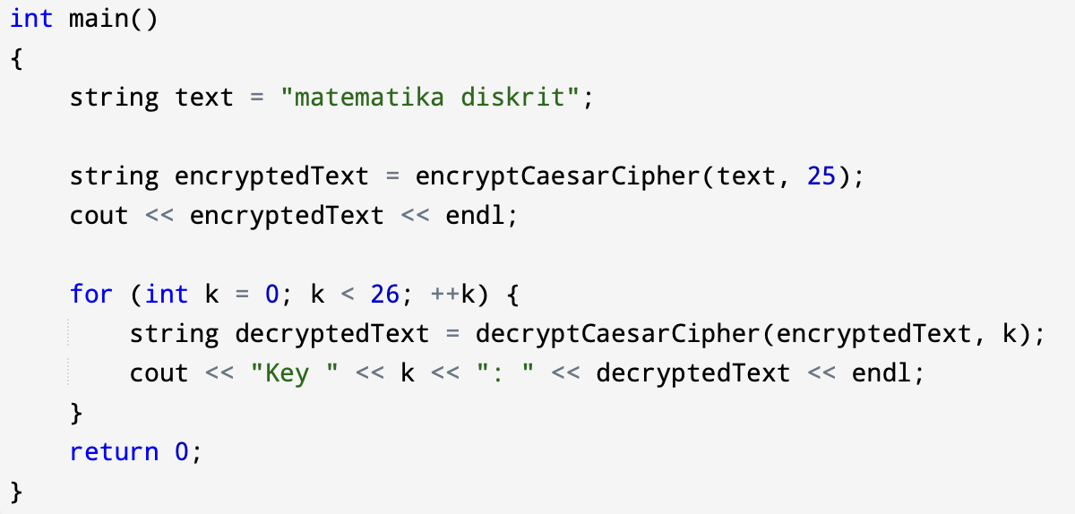
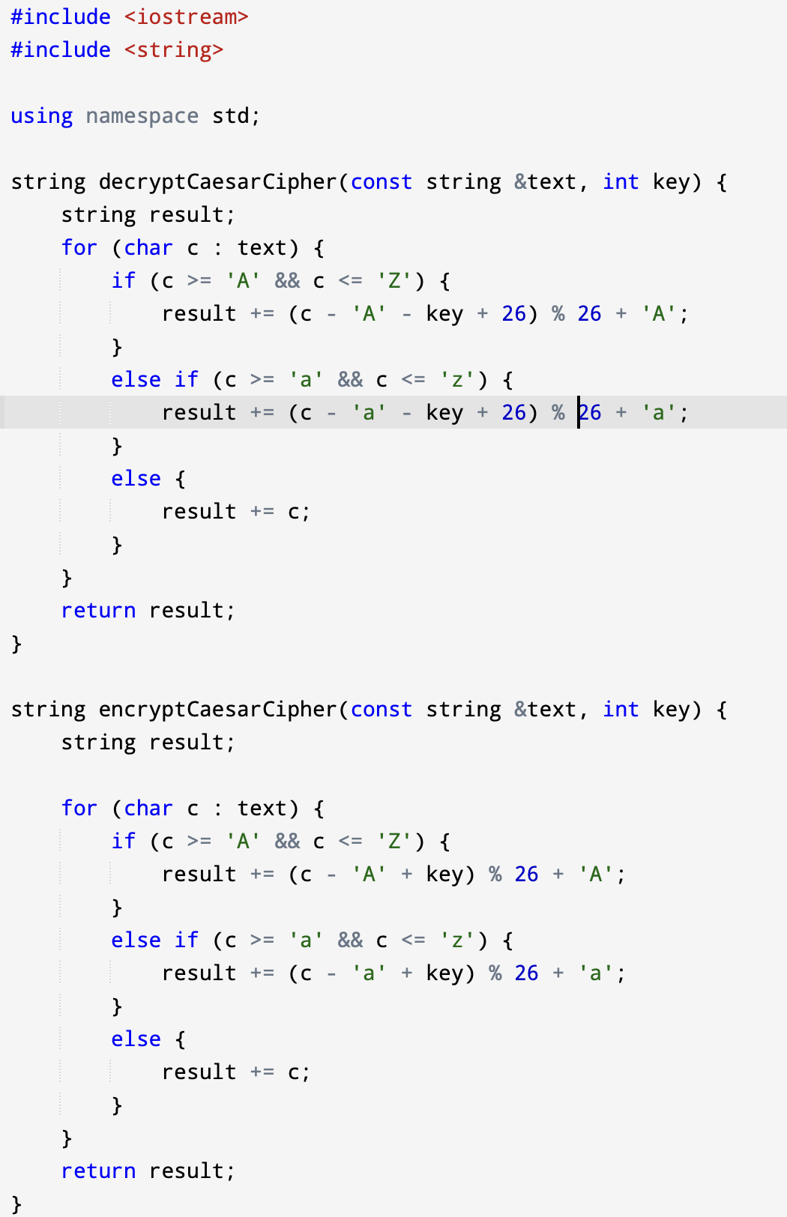
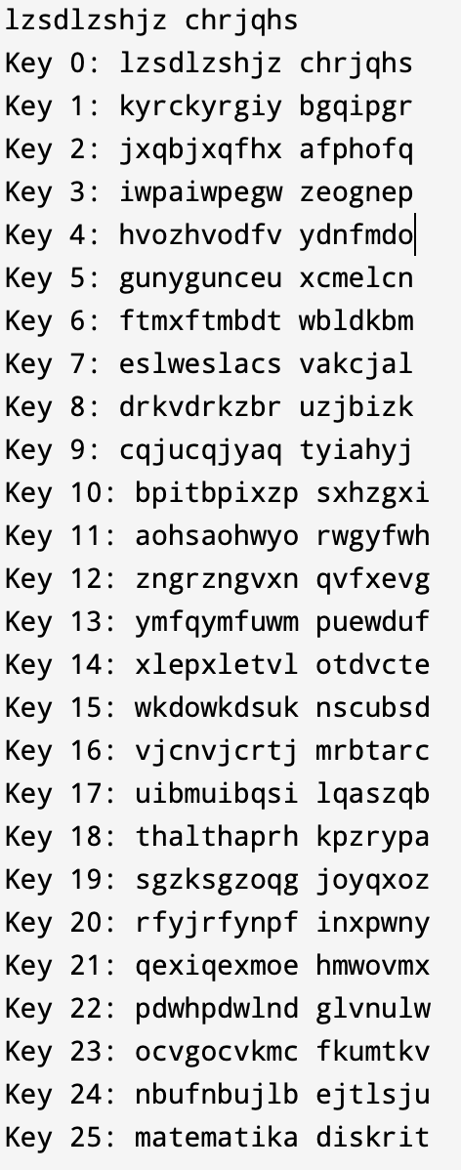
Code in C++

Slide 11
Prime numbers
Def: A positive integer p is prime if the only positive factors of p are 1 and p
If there are other factors, it is composite
Note that 1 is not prime!
It’s not composite either – it’s in its own class
Def: An integer n is composite if and only if there exists an integer a such that a | n and 1 < a < n
Notes:
11

Slide 12
Fundamental theorem of arithmetic
Every positive integer greater than 1 can be uniquely written as a prime or as the product of two or more primes where the prime factors are written in order of non-decreasing size
Examples
100 = 2 * 2 * 5 * 5
182 = 2 * 7 * 13
29820 = 2 * 2 * 3 * 5 * 7 * 71
Notes:
12

Slide 13
Composite factors
If n is a composite integer, then n has a prime divisor less than or equal to the square root of n
Notes:
13

Slide 14
Showing a number is prime
Show that 113 is prime
Solution
The only prime factors less than √113 = 10.63 are 2, 3, 5, and 7
Neither of these divide 113 evenly
Thus, by the fundamental theorem of arithmetic, 113 must be prime
Notes:
14

Slide 15
The prime number theorem
The ratio of the number of primes not exceeding x and x/ln(x) approaches 1 as x grows without bound
Rephrased: the number of prime numbers less than x is approximately x/ln(x)‏
When x = 2⁵¹², # of primes = 2⁵¹²/512 ln(2)
Notes:
15

Slide 16
Greatest common divisor
The greatest common divisor of two integers a and b is the largest integer d such that d | a and d | b
Denoted by gcd(a,b)‏
Examples
gcd (24, 36) = 12
gcd (17, 22) = 1
gcd (100, 17) = 1
Notes:
16

Slide 17
Relative primes
Two numbers are relatively prime if they don’t have any common factors (other than 1)‏
Rephrased: a and b are relatively prime if gcd (a,b) = 1
gcd (25, 39) = 1, so 25 and 39 are relatively prime
Notes:
17

Slide 18
Pairwise relative prime
A set of integers a₁, a₂, … a_{n} are pairwise relatively prime if, for all pairs of numbers, they are relatively prime
Formally: The integers a₁, a₂, … a_{n} are pairwise relatively prime if gcd(a_{i}, a_{j}) = 1 whenever 1 ≤ i < j ≤ n.
Example: are 10, 17, and 21 pairwise relatively prime?
gcd(10,17) = 1, gcd (17, 21) = 1, and gcd (21, 10) = 1
Thus, they are pairwise relatively prime
Example: are 10, 19, and 24 pairwise relatively prime?
Since gcd(10,24) ≠ 1, they are not
Notes:
18

Slide 19
More on gcd’s
Given two numbers a and b, rewrite them as:
Example: gcd (120, 500)‏
120 = 2³*3*5 = 2³*3¹*5¹
500 = 2²*5³ = 2²*3⁰*5³
Then compute the gcd by the following formula:
Example: gcd(120,500) = 2^{min(3,2)}3^{min(1,0)}5^{min(1,3)} = 2²3⁰5¹ = 20
Notes:
19

Slide 20
Least common multiple
The least common multiple of the positive integers a and b is the smallest positive integer that is divisible by both a and b.
Denoted by lcm (a, b)‏
Example: lcm(10, 25) = 50
What is lcm (95256, 432)?
95256 = 2³3⁵7², 432=2⁴3³
lcm (2³3⁵7², 2⁴3³) = 2^{max(3,4)}3^{max(5,3)}7^{max(2,0)} = 2⁴3⁵7² = 190512
Notes:
20

Slide 21
lcm and gcd theorem
Let a and b be positive integers. Then a*b = gcd(a,b) * lcm (a, b)‏
Example: gcd (10,25) = 5, lcm (10,25) = 50
10*25 = 5*50
Example: gcd (95256, 432) = 216, lcm (95256, 432) = 190512
95256*432 = 216*190512
Notes:
21

Slide 22
Example Proof
Prove or disprove that n² - 79n + 1601 is prime, whenever n is a positive integer.
(Disprove)‏
When n = 1601,
n² - 79n + 1601 = 1601 (1601 - 79 + 1)‏ = 1601 * 1523

